Slide 1






Slide 2
Introduction
Gayathri Mulagund
Data Analyst
www.linkedin.com/in/gayathri-mulagund

Slide 3
An online site aggregation platform Connects merchants and their products to marketplace Founded in February 2015 by Tiago Dalvi Over 200,000 users in 180 countries Over 45,000 shopkeepers and retailers as clients Dataset information - 100k orders from 2016 to 2018
Olist
Brazilian e-commerce marketplace integrator

Slide 4
Attracting more shopkeepers by enhancing the service and attracting more end-customers through a broader product spectrum and higher satisfaction
Business Objective
(B2P)

Slide 5
Operations
Time Series Analysis
Product Categories
Price Distribution
Payment Details
Reviews

Slide 6
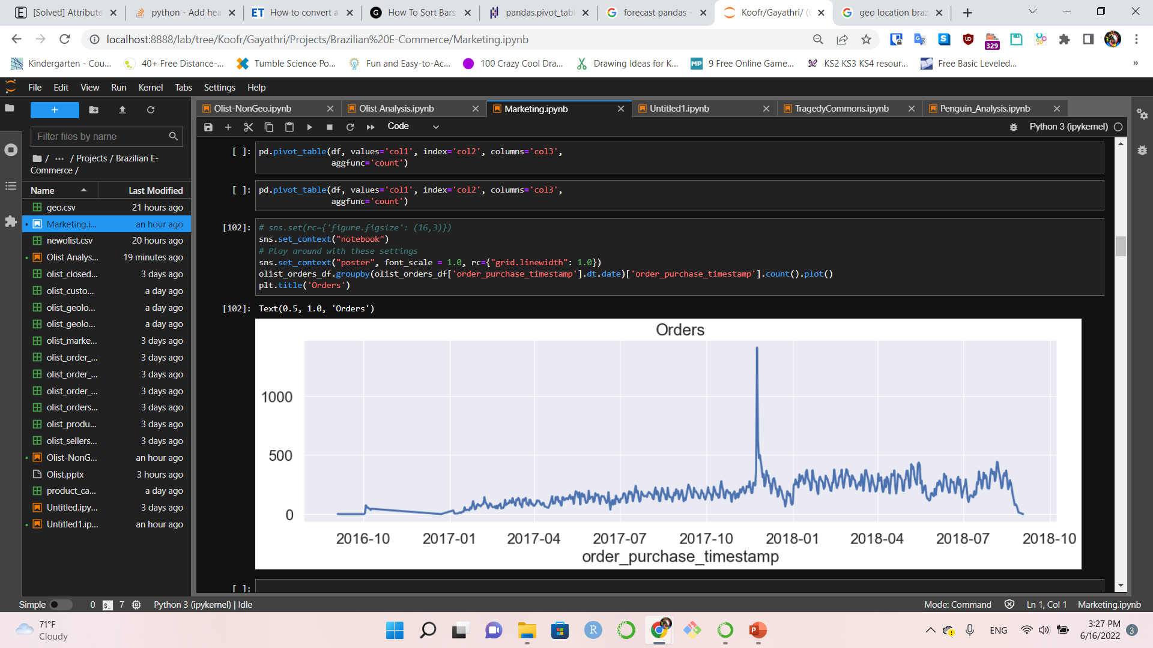
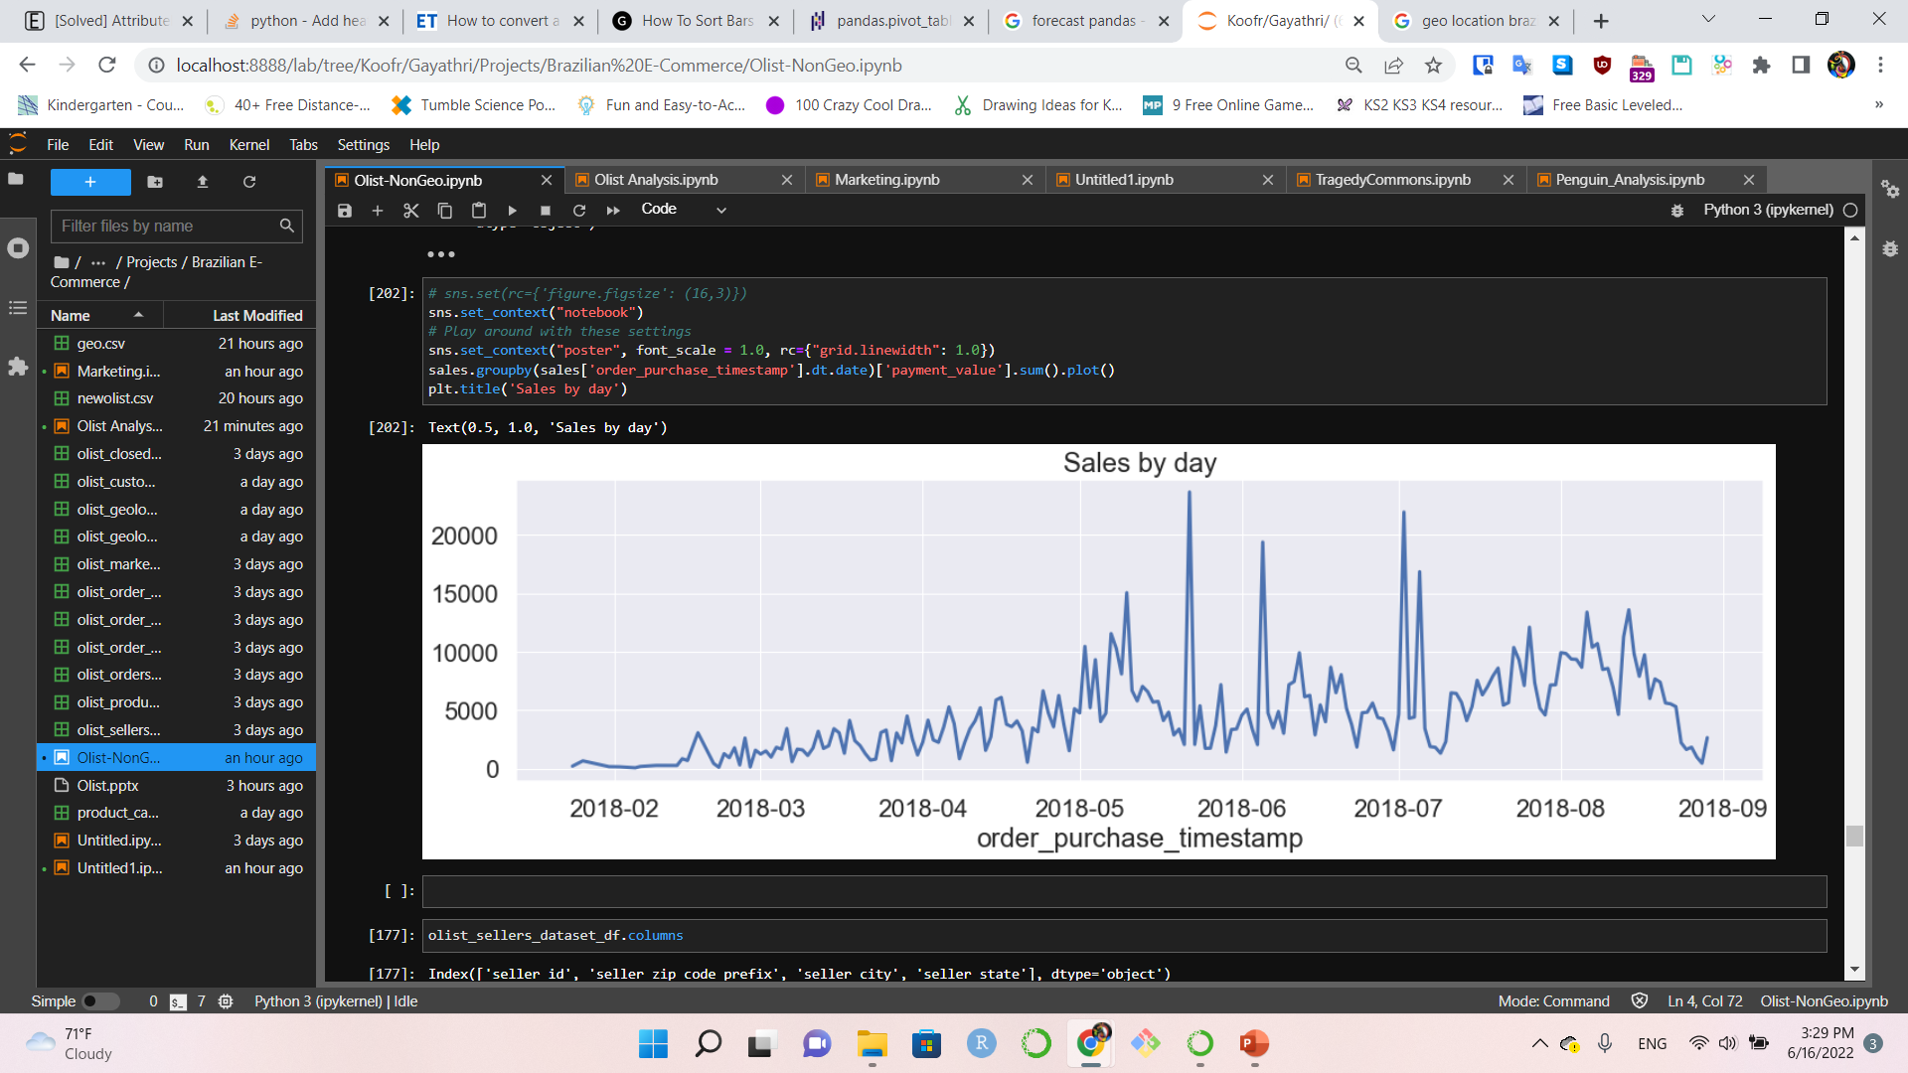
Orders – Quantity 2016 -10 to 2018 - 09
Black Friday 2017
Orders – Sales 2018 - 02 to 2018 - 08
Sales Growth:
May 2018 –
Jul 2018

Slide 7
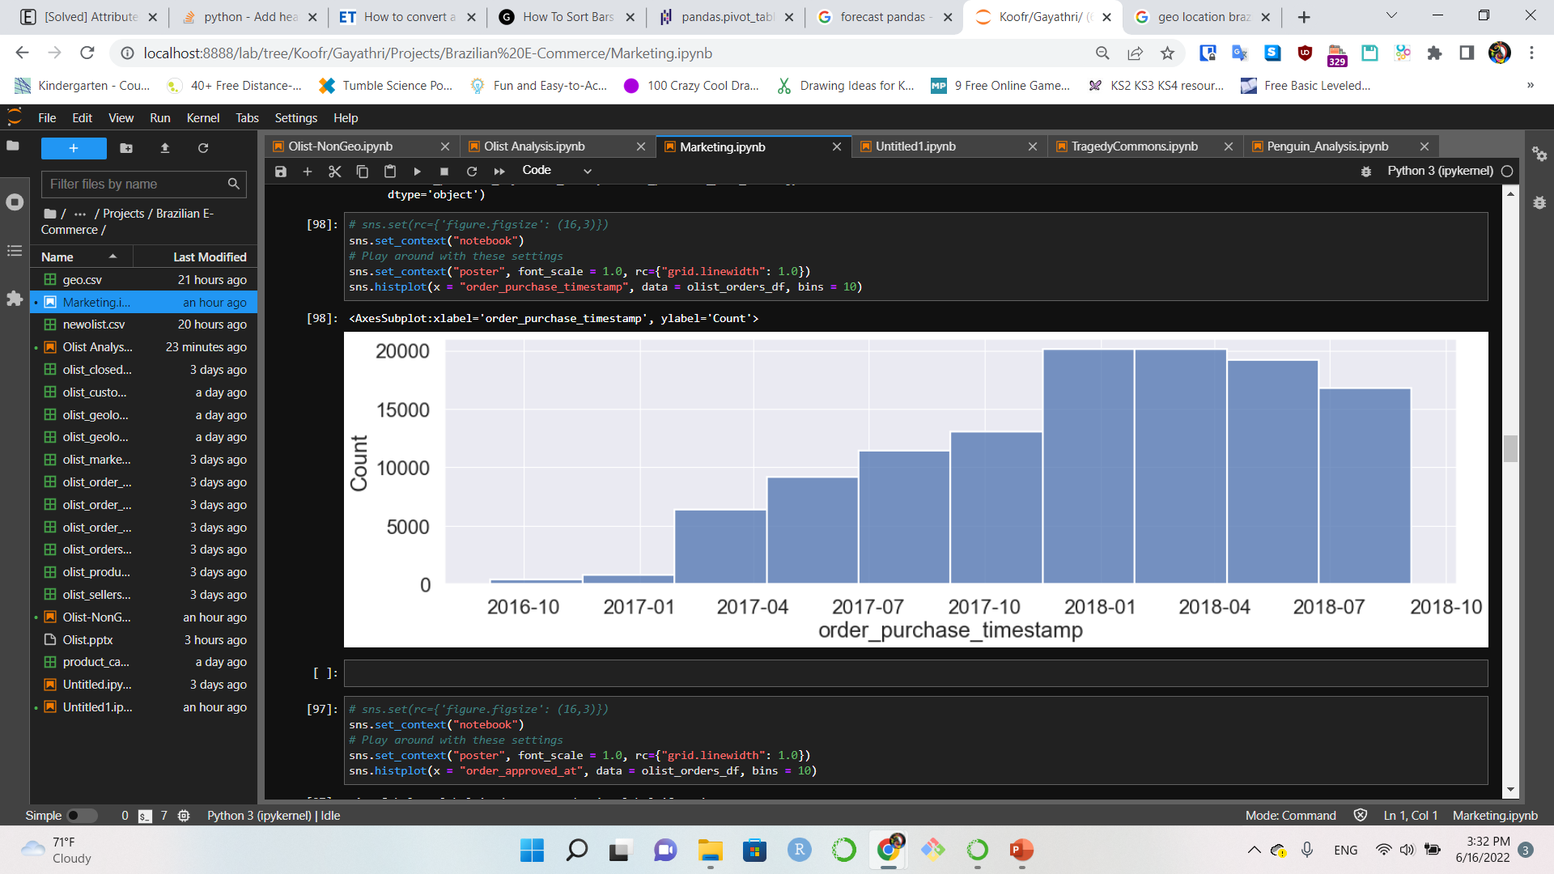
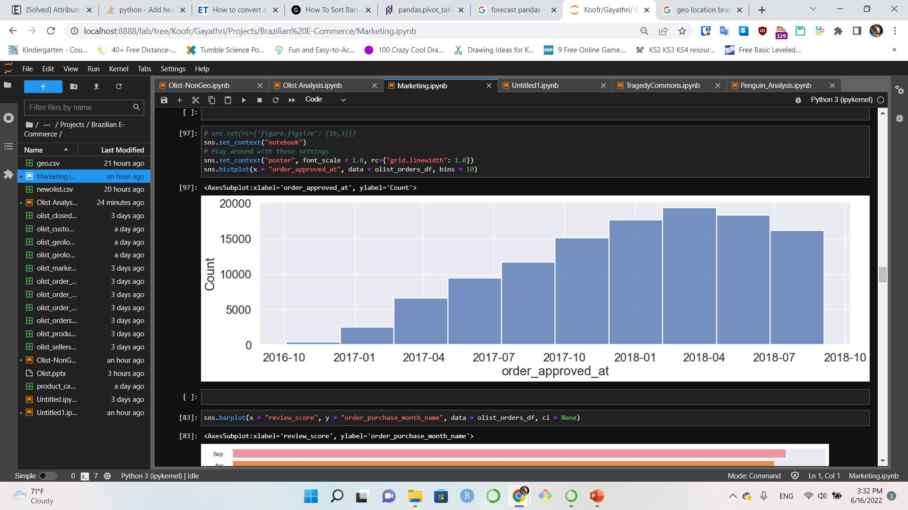
Order Processing
Customer orders
Jan 2017 & Oct 2017
More approvals than orders
Nov 2017:
Order approval dip
Order Approvals

Slide 8
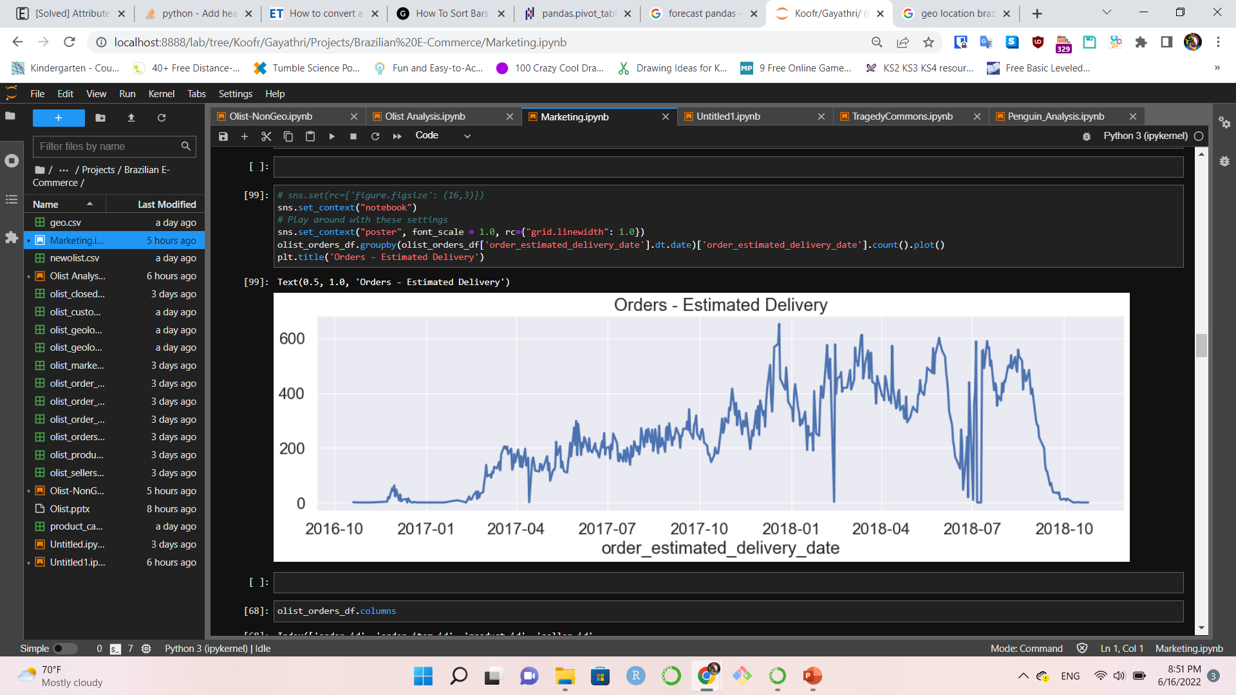
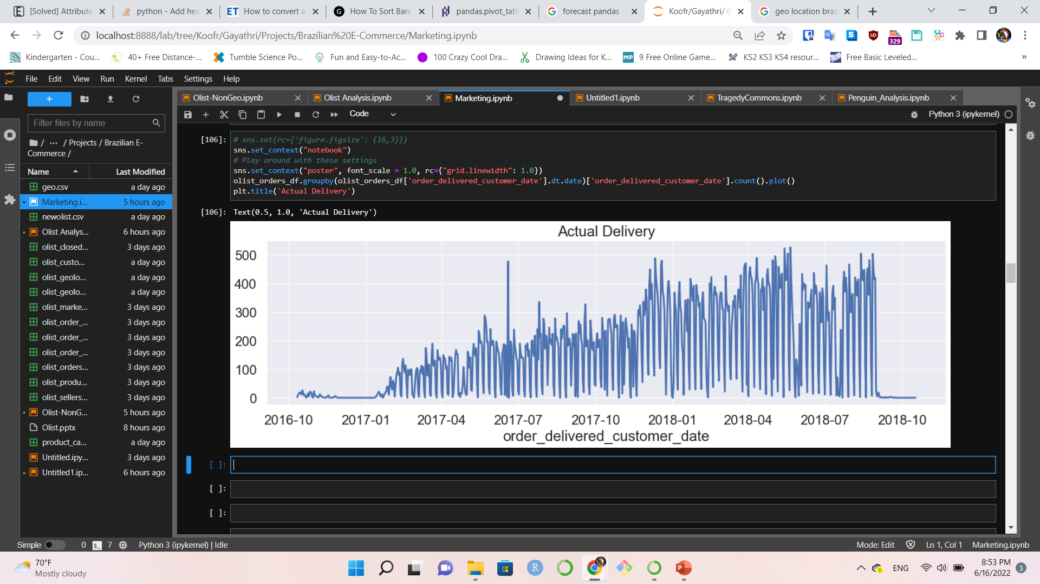
Orders - Estimated Delivery vs Actual Delivery
Next step:
Requires a deeper analysis for specific time frame

Slide 9
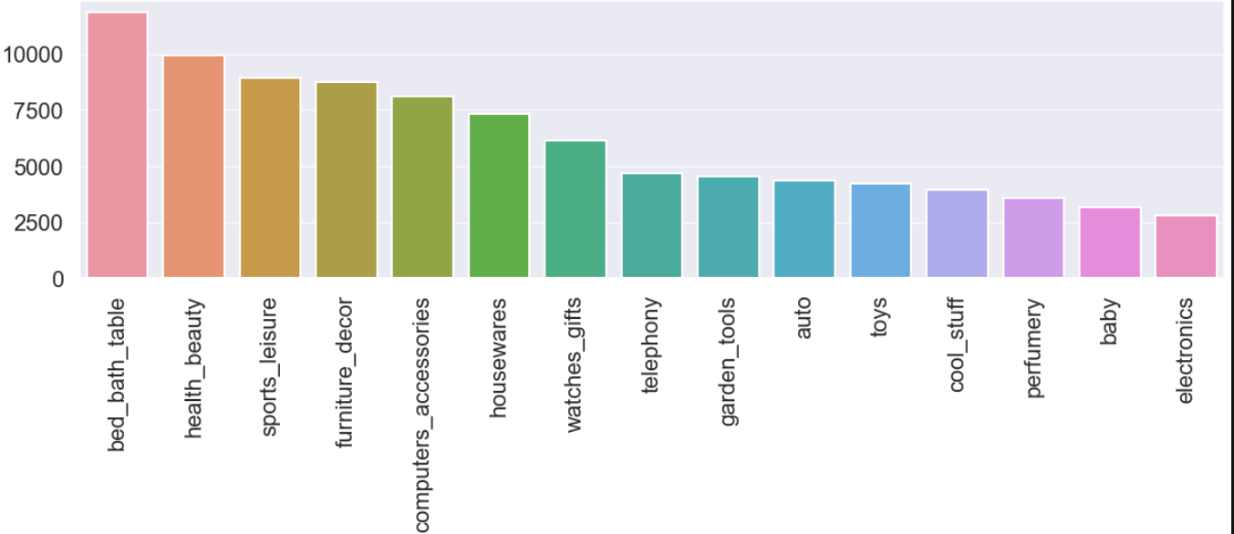
Product Purchase Frequency – Top Categories
Serves a very wide market segment with diverse products

Slide 10
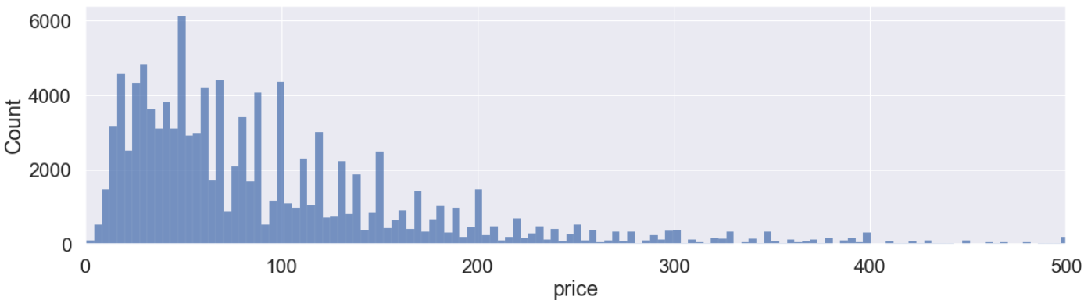
Price Distribution
right skewed price distribution
Loss Leader Strategy
Sales
Categories | Total Sales
Health & Beauty | 153025 Brazilian Real
Watches & Gifts | 117179 Brazilian Real
Houseware | 103150 Brazilian Real

Slide 11
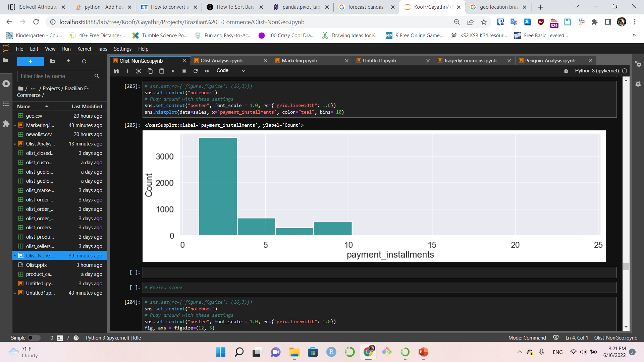
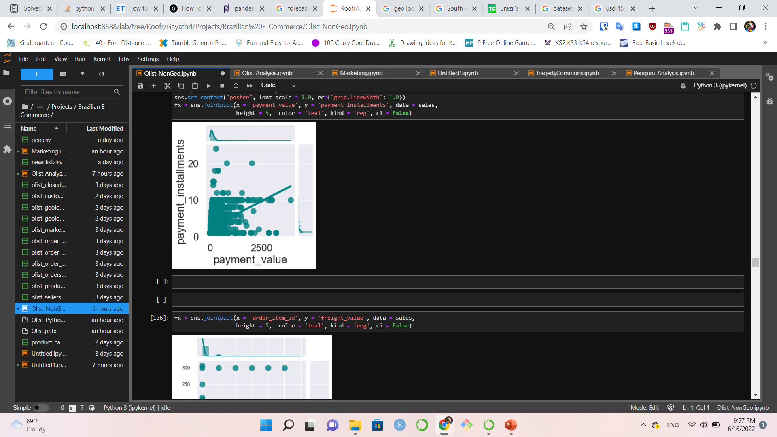
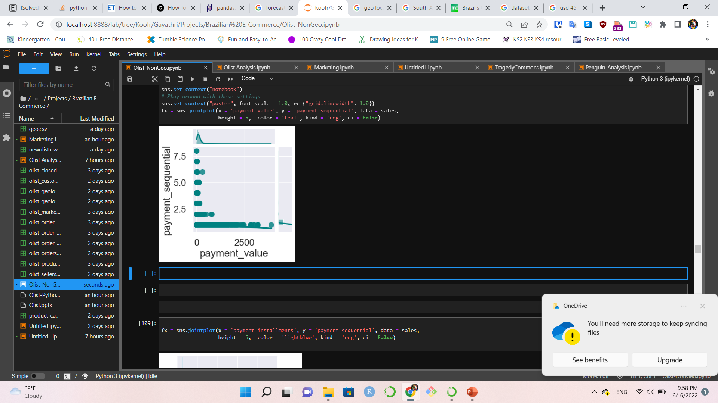
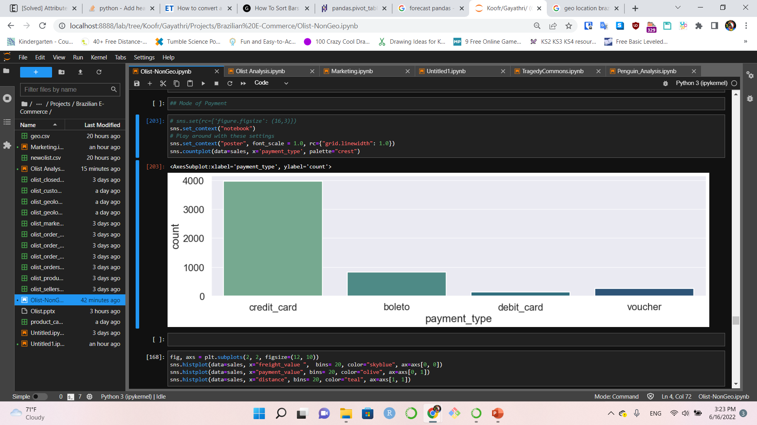
Payments
Low installments
Low Purchasing Power
Credit cards Preferred payment method

Slide 12
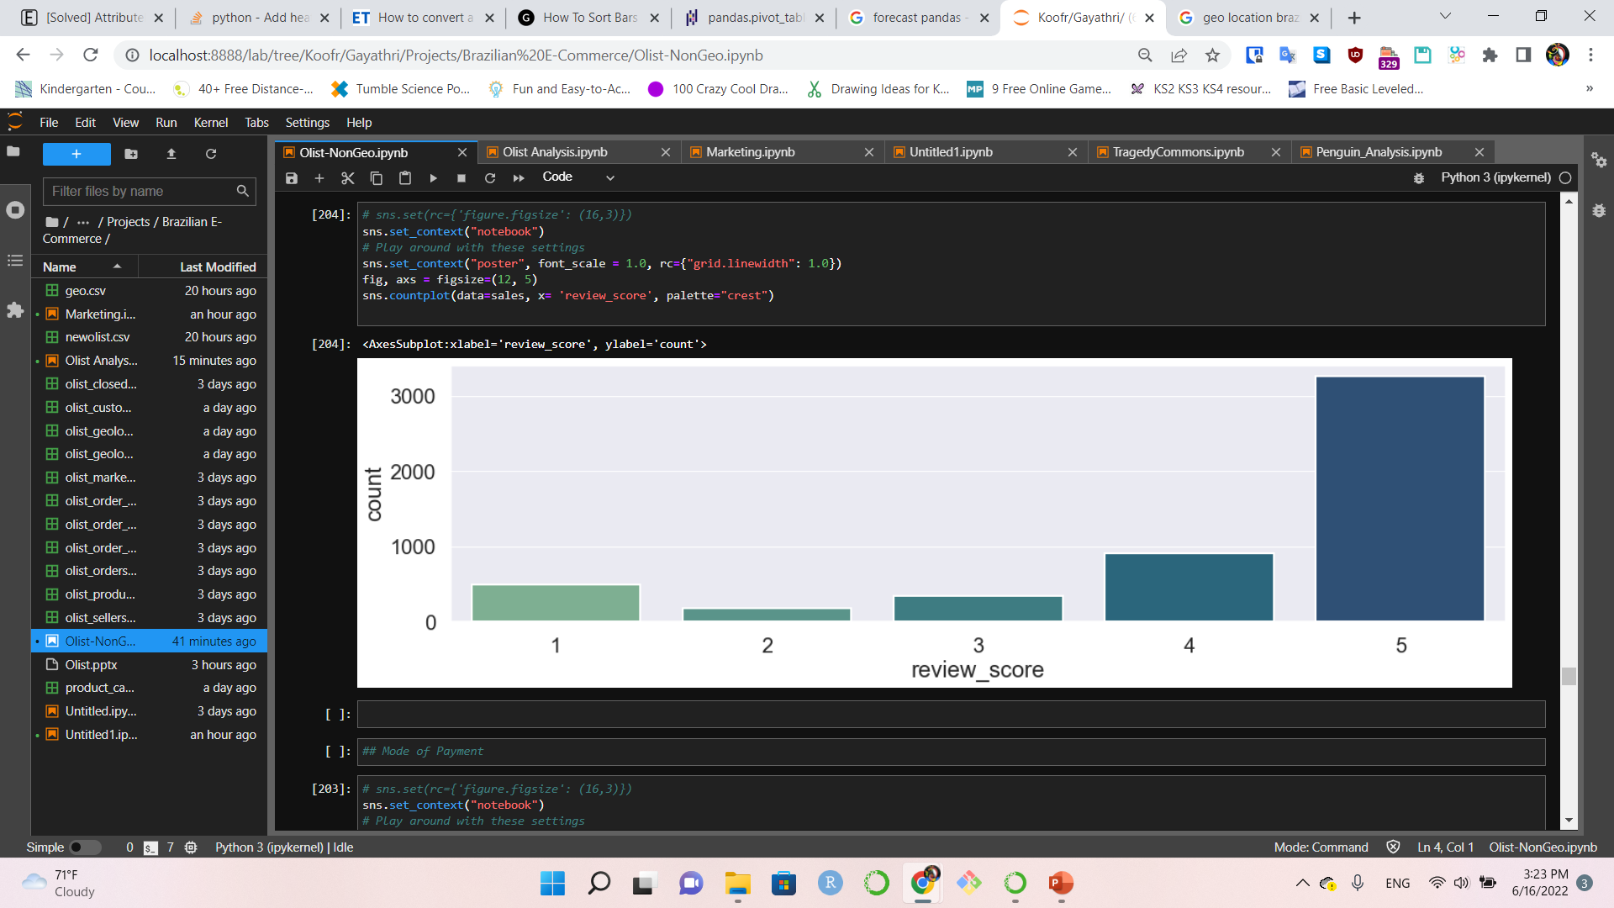
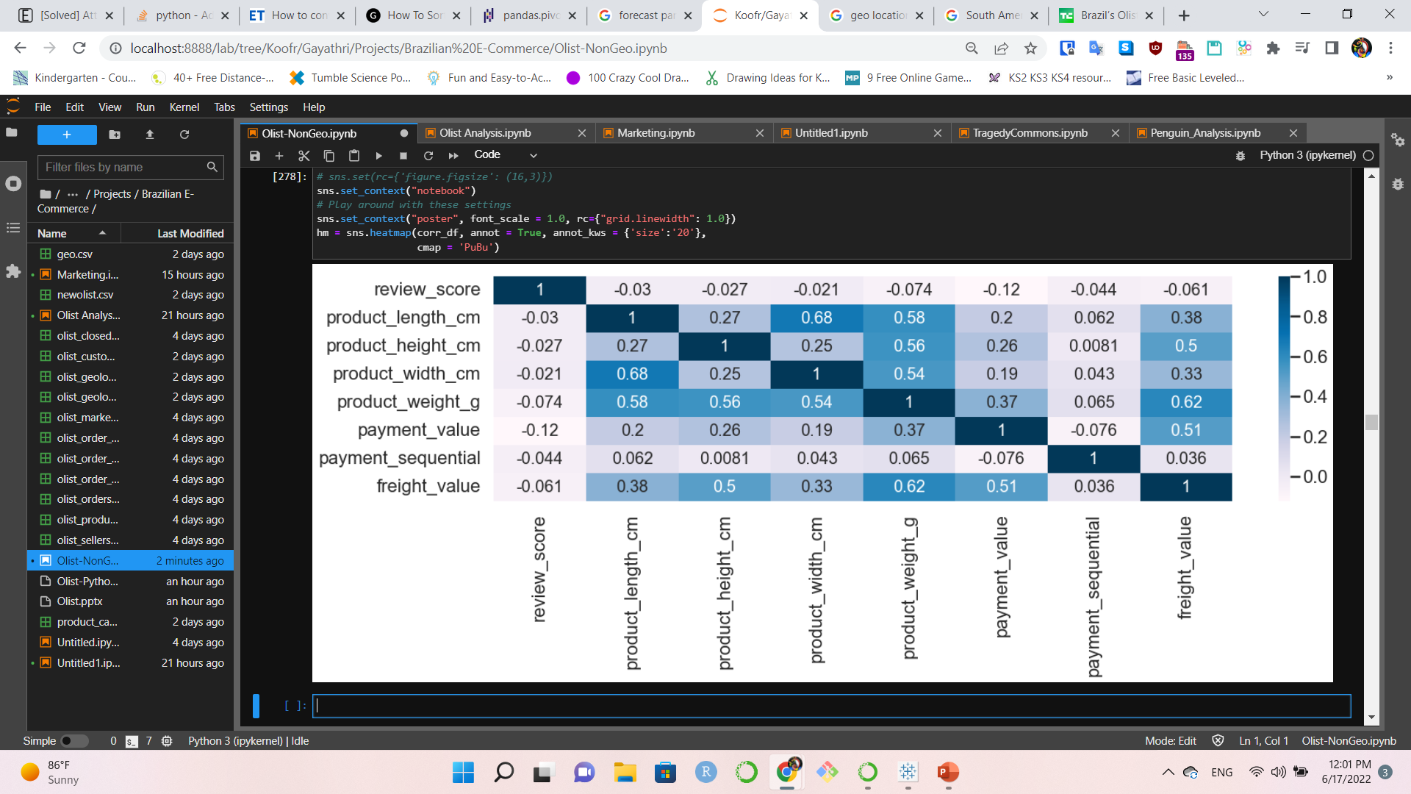
Reviews
Maximum number
of high-score reviews
Review Score
Correlations

Slide 13
Geo Locations
Customer Base – State and City
Geo Maps & Heat Maps

Slide 14
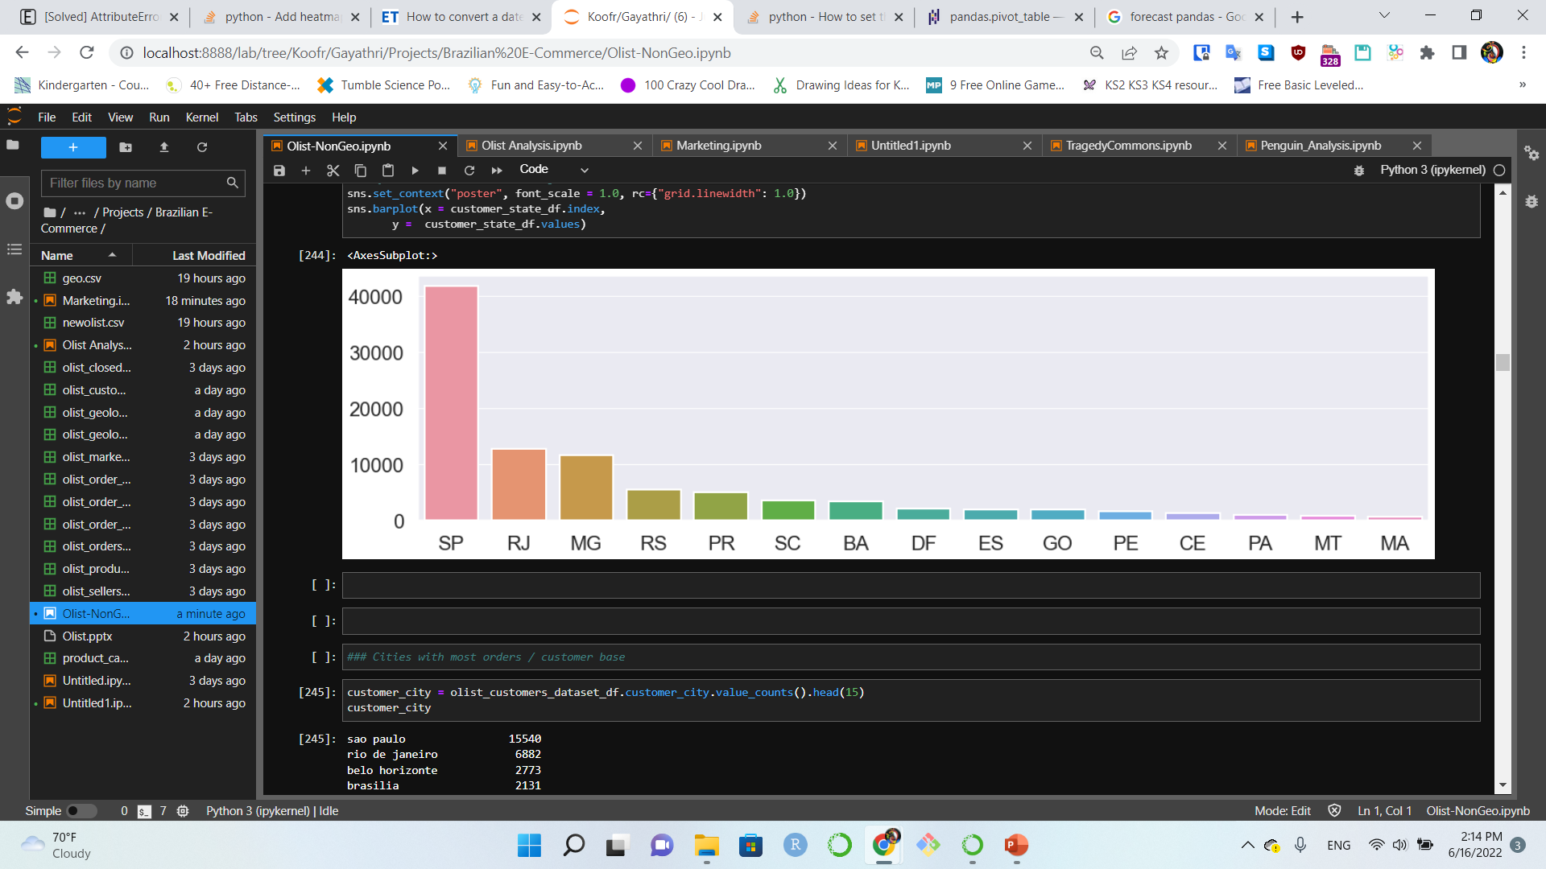
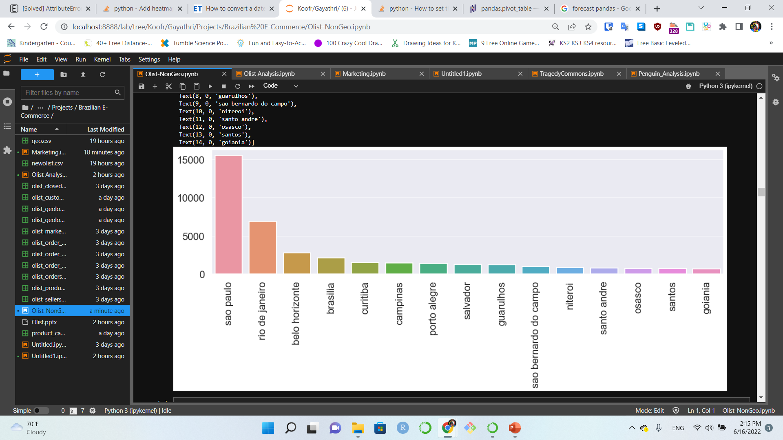
Frequency of Purchase by Customers
States
SP SAO PAULO
RJ RIO DE JANEIRO
MG MINAS GERAIS
RS RIO GRANDE DO SUL
PR PARANÁ
Cities
SAO PAULO
Cities | Total Orders
Sao Paulo | 15540
Rio De Janeiro | 6882
Belo Horizonte | 2773

Slide 15
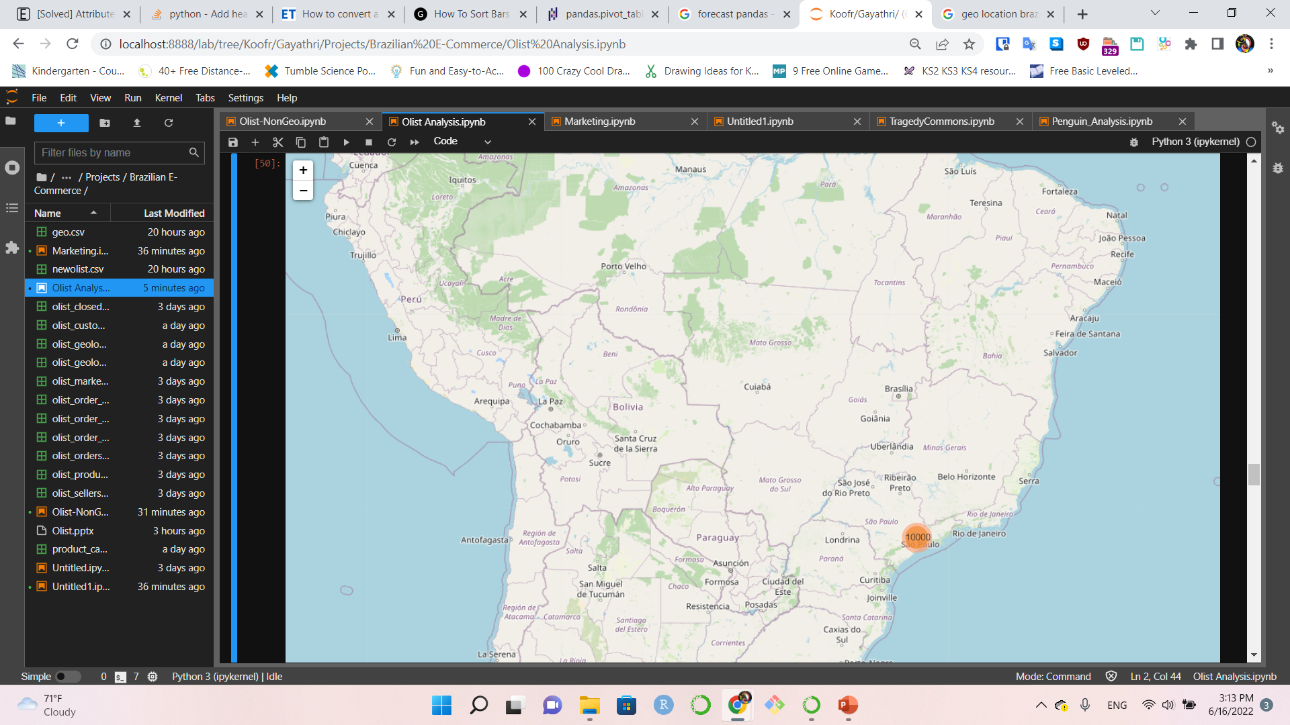
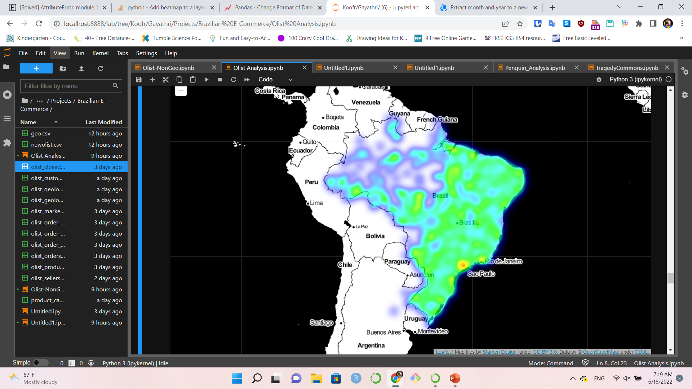
Geo Map & Heat Map
SAO PAULO

Slide 16
Diverse market segment Loss Leader Strategy Wide Customer Base Positive Customer Reviews Sao Paulo
Conclusions

Slide 17
What’s next ?
Marketing:
Merchant growth over time
How this growth impacted Sales ?
Orders:
Inventory vs Sales analysis
Logistics analysis
Customers:
Customer Review analysis
Sao Paulo – Best Practices learning

Slide 18
Thank you!
Kaggle - Data Source
Excel, PowerPoint and Python
Instructional videos on YouTube
Python help on the internet
Vadim, my instructor and project mentor
Dennis, my instructor
All at TTP & Fullstack Academy
My fellow team members

